Slide 1
Text-based prediction of book review popularity
Presented By:
Saira Yeasmin(1805037)
Sanjana Binte Siraj(1805037)

Slide 2
Information About Base Paper
Paper title :Text-based prediction of book review popularity
Where Published :CS 229 projects, Spring 2021 edition
Publication Year : 2021
Paper link: Here
Problem Definition:
Goodreads, a popular book cataloguing and community site, allows readers to track, rate and review books as well as like and comment on others' reviews. These reviews are sorted on the book's page based on the number of likes and comments first. So, if one wants to build up a strong presence in this book review community, one must know how to write reviews that pull in engagement from the audience. Hence, the need for a machine learning model that can distinguish popular reviews from unpopular ones.
Key idea: Exploration of syntactic and semantic elements that distinguish popular reviews from unpopular ones by building popularity classification model.

Slide 3
Solution Overview
Logistic regression, gradient boosting and neural networks were used to classify book reviews as popular or unpopular in order to understand the features important to writing a popular book review.
Four feature subsets:
A)4 non-textual features
B)12 non-textual and textual features
C)non-textual and textual plus BOW
D)non-textual and textual plus TF-IDF

Slide 4
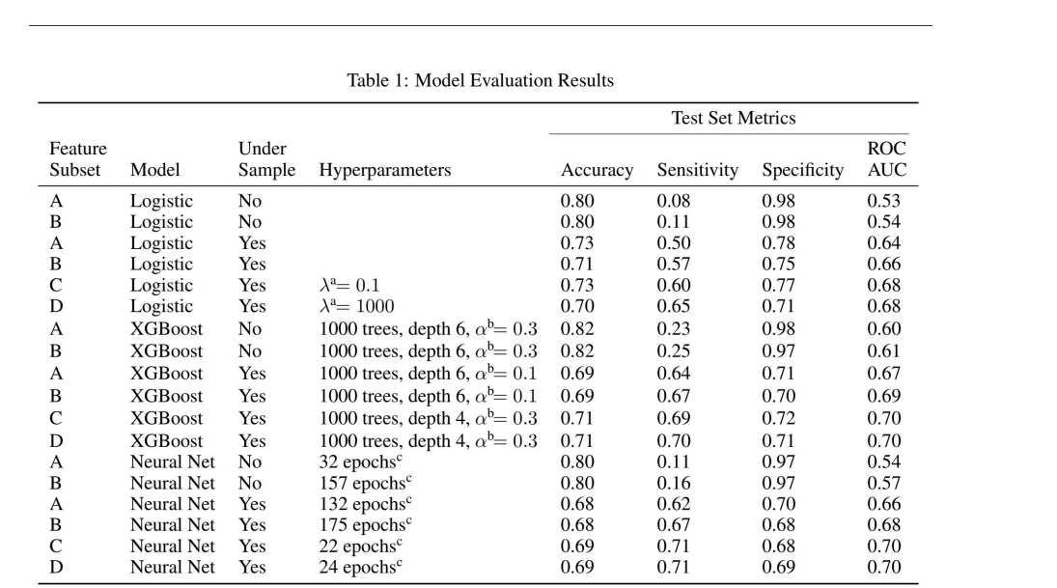
Results:

Slide 5
Code and data availability:
Github code link:
https://github.com/bridgetdaly/goodreads_ML/tree/main
Dataset link:
https://github.com/MengtingWan/chainRec/tree/master/data

Slide 6
Proposed Experiment:
Handling unbalanced dataset by inclusion of more samples.
Integrating text script of tiktok's book review clips into the dataset.
Applying more advanced text representations techniques such as word embeddings(Word2Vec) or contextual embeddings(BERT,GPT) .
Adding more features like book and author's popularity and time of review compared to publishing of the book.
Comparing results between lemmatization and stemming.
Adding regression model for prediction of number of likes alongside popularity of classification.

